Slide 1
Urban growth modeling using Cellular Automata
Group 5
Tijn Schickendantz
Anton Andersen
Alexander Künnen
Xinhai Li

Slide 2
Agenda
Project Motivation & Research question
Model
Analysis
Conclusion

Slide 3
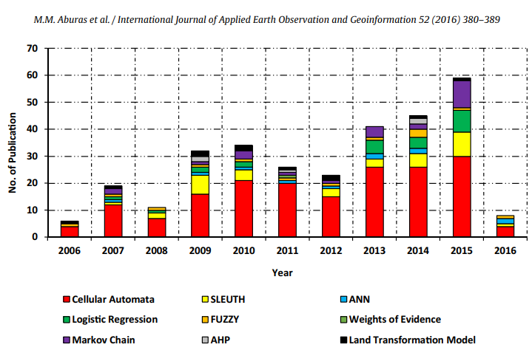
Motivation
Large majority of people expected to live in urban areas by 2050 (UN, 2014).
Development of urban areas is considered a complex system, where local structures define the growth of surrounding area.
Cellular Automata forms majority of research in urban growth with increasing popularity over time.
Can lead to new insights about the form of urban growth and prediction of city expansion. Can be used for urban planning and interventions that improve the quality of urban areas.
Notes:
Second point -> due to e.g. agglomeration effects, as opposed to being random.
Third point -> Simple models that capture complex patterns which emerge in systems

Slide 4
Hypothesis
Research question: Can we develop a model that finds underlying patterns and structures in how urban areas grow and, if so, do they resemble the ones that are found in actual cities?
The complexity measures used in analysis indicates that urban growth is a complex system.
There are parameter settings for the model that can reproduce the patterns found in actual cities.
We can expand the urban growth model to describe uneven growth patterns, while still producing indications of complex structures.
Notes:
Overarching research question: Can we develop a model that finds underlying patterns and structures in how urban areas grow and, if so, do they resemble the ones that are found in actual cities?
Third bullet: which Alex will tell you more about.
This is important because if we can find evidence for our hypothesis, then it would indicate that there is an underlying structure to how cities grow, which is not immediately apparent on the surface.

Slide 5
The Model

Slide 6
Model - General Picture
Step 1
Step 2
Step 3
Initializing Grid
Grid Size of 75 x 75
Neighborhood Type: Moore Neighborhood
Cell Types: Vacant, Residential, Industrial, Commercial
3 Commercial cells, 4 Industrial cells, 25 Residential cells.
Computing Transition Potential
Weight Table
Transition Probability Matrix
Run simulation
Following hierarchical transition pattern
Exogenous growth rate
White, R., & Engelen, G. (1993). Cellular automata and fractal urban form: a cellular modelling approach to the evolution of urban land-use patterns. Environment and planning A, 25(8), 1175-1199.

Slide 7
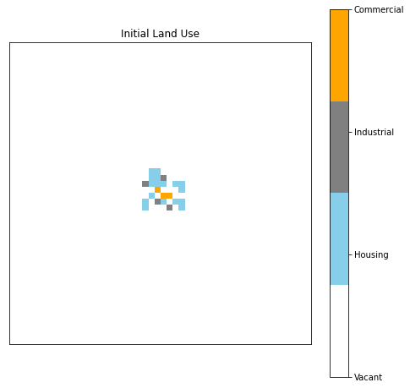
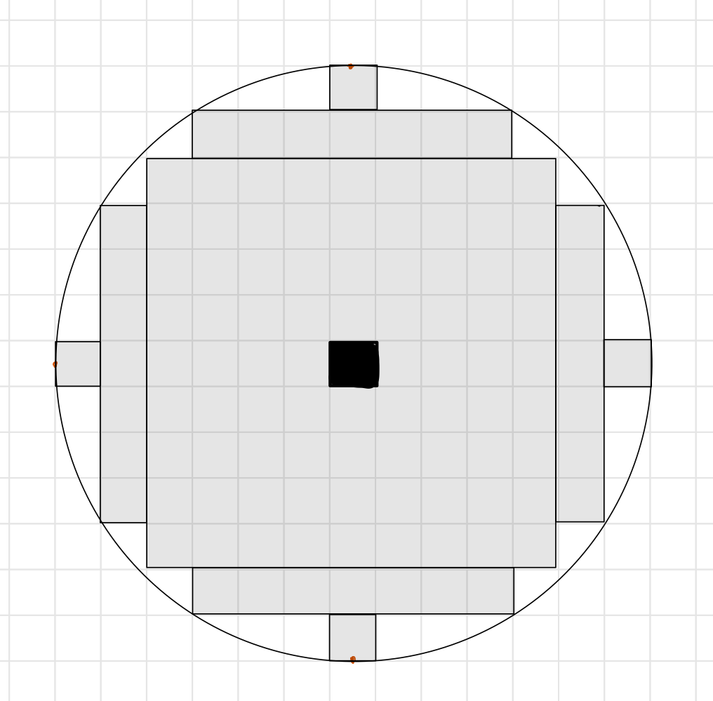
Model - Step 1
Grid Initialization
Grid Size(system size): 75 x 75
Adjusted Moore Neighborhood
Types of Cells: Vacant, Residential, Industrial, Commercial
Initial cells placement
White, R., & Engelen, G. (1993). Cellular automata and fractal urban form: a cellular modelling approach to the evolution of urban land-use patterns. Environment and planning A, 25(8), 1175-1199.

Slide 8
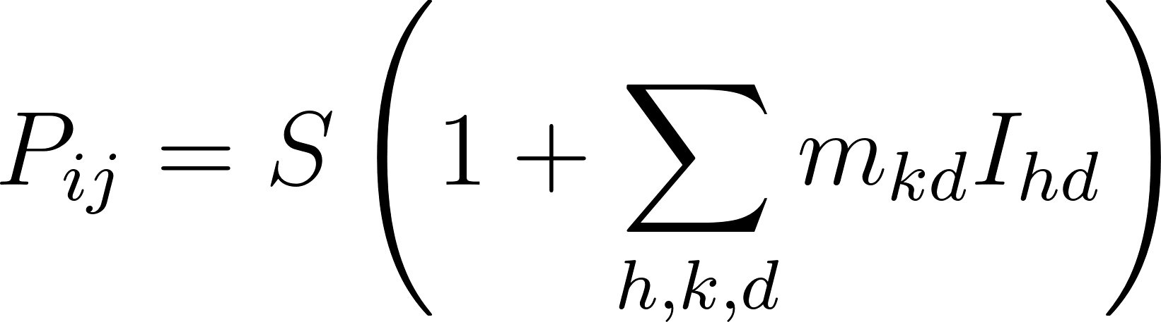
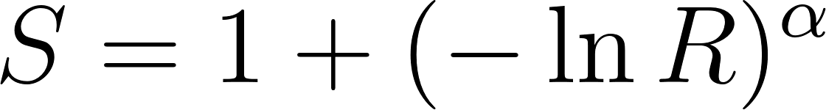
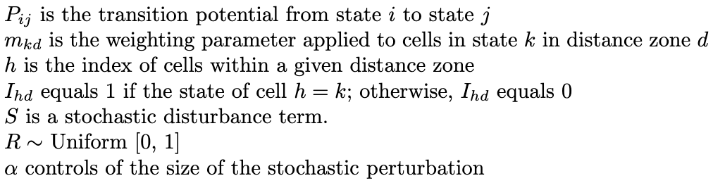
Model - Step 2
Transition Potential
，
White, R., & Engelen, G. (1993). Cellular automata and fractal urban form: a cellular modelling approach to the evolution of urban land-use patterns. Environment and planning A, 25(8), 1175-1199.
Notes:
In the paper, the transition potential Pij, which represents the likelihood of transitioning from state i to state j, is calculated using a formula

Slide 9
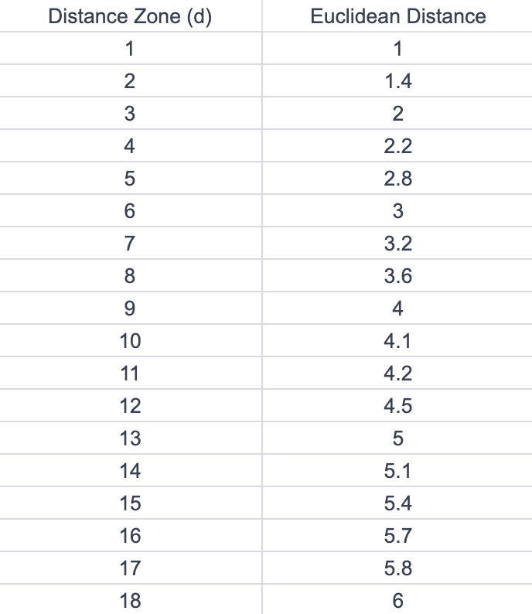
Model - Step 2 (Weight Table)
Vacant → Commercial
State k | Distance Zone 1 | Distance Zone 2 | Distance Zone 3 | …
Commercial | 6 | 3.5 | 3 | …
Industrial | -1 | -1 | -1 | …
Residential | 4 | 3.5 | 3 | …
Vacant | 0 | 0 | 0 | …
Vacant → Industrial, Vacant → residential, residential → commercial …
White, R., & Engelen, G. (1993). Cellular automata and fractal urban form: a cellular modelling approach to the evolution of urban land-use patterns. Environment and planning A, 25(8), 1175-1199.
Notes:
With this weight_table, we are able to compute the transition potential from one states to the other 3 states for every single cells in the grid.

Slide 10
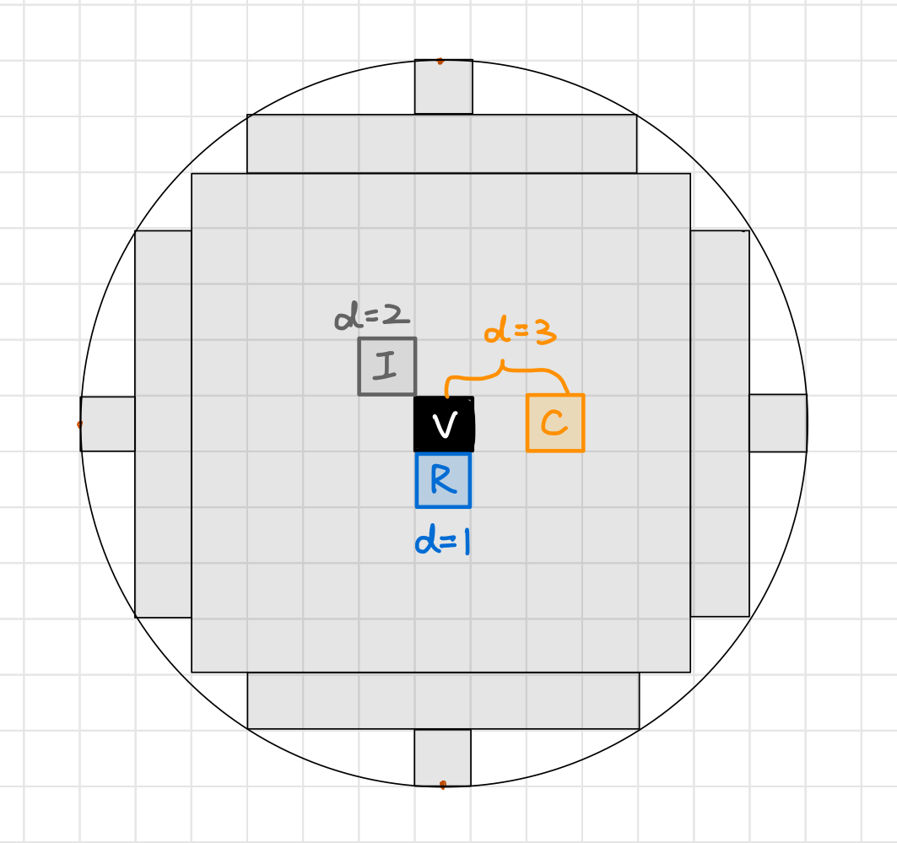
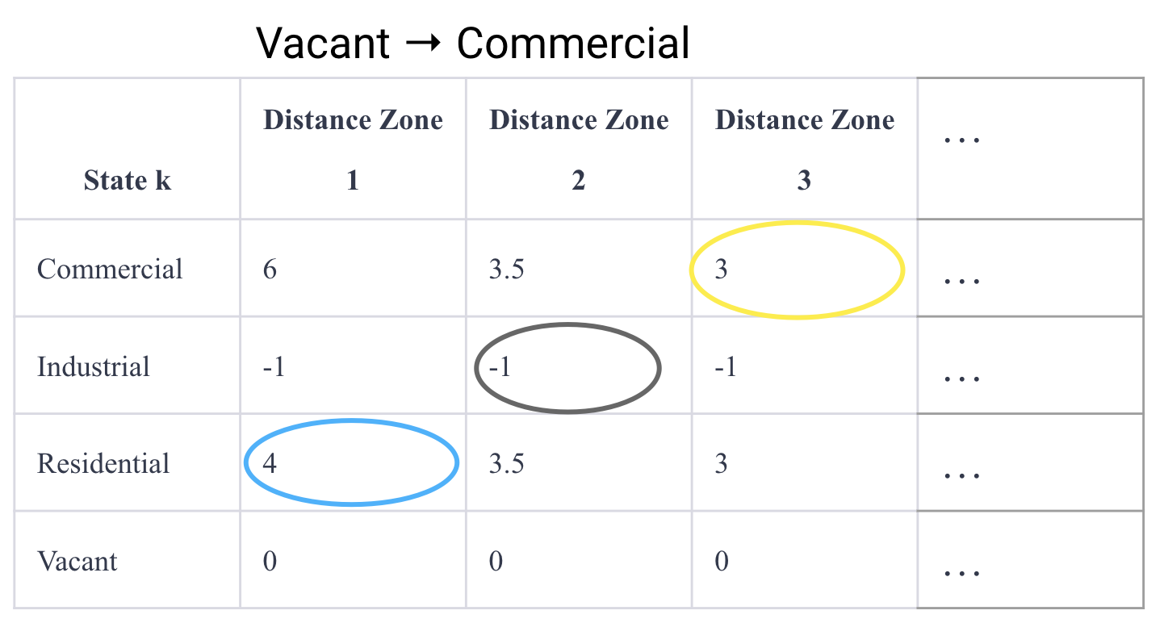
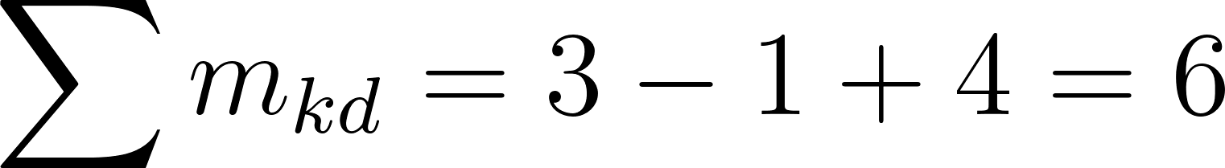
Model - Step 2 (Weight Table example)
The total contribution of a vacant cell’s neighbors helps it to convert into commercial cells

Slide 11
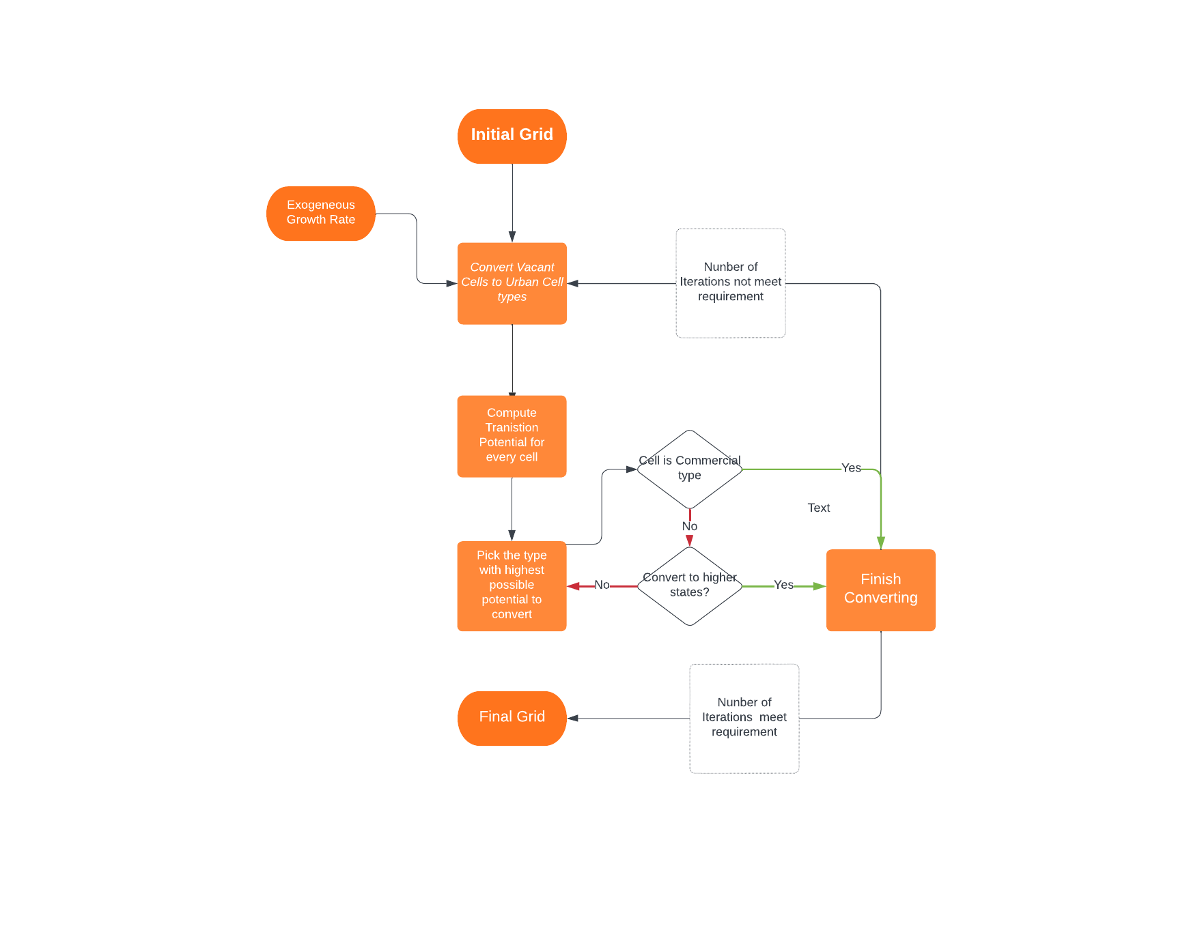
Model - Step 3
Simulating
Simulation Rules
Exogenous Growth Rate of Urban type cells
Transition potential
Hierarchy of Land-use States. (Low) V → R → I → C (High)
White, R., & Engelen, G. (1993). Cellular automata and fractal urban form: a cellular modelling approach to the evolution of urban land-use patterns. Environment and planning A, 25(8), 1175-1199.

Slide 12
Analysis

Slide 13
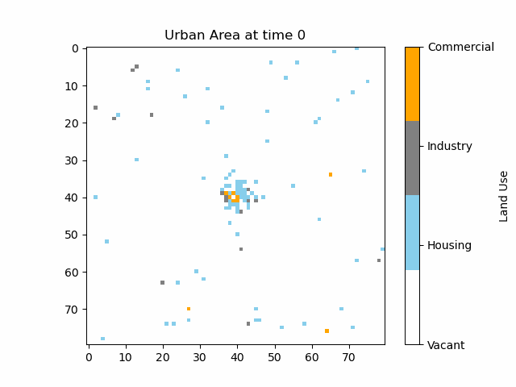
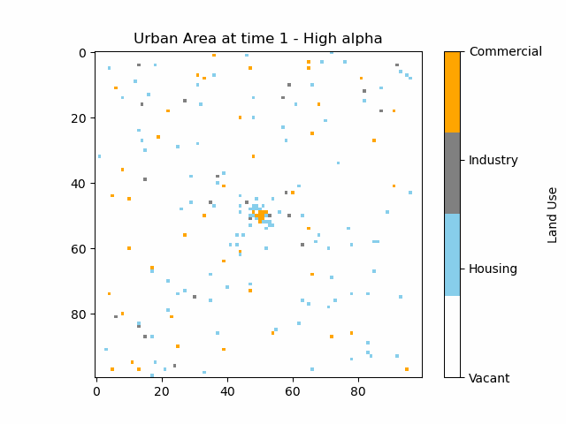
Analysis I - Model Behaviour
alpha = 2.5
C = 0.001
H = 0.01
I = 0.002
alpha = 4
C = 0.005
H = 0.01
I = 0.002

Slide 14
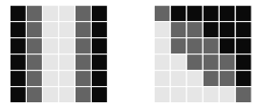
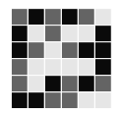
Analysis II - Conditional Entropy
Notion of ‘’Orderedness’’
Entropy (H) versus conditional Entropy (G).
Conditional entropy discriminates structurally different 2D patterns.
H = 1.585 H = 1.585 H= 1.585
G = 0.40 G = 0.756 G = 1.434
Javaheri Javid, M. A., Blackwell, T., Zimmer, R., & Al-Rifaie, M. M. (2015).

Slide 15
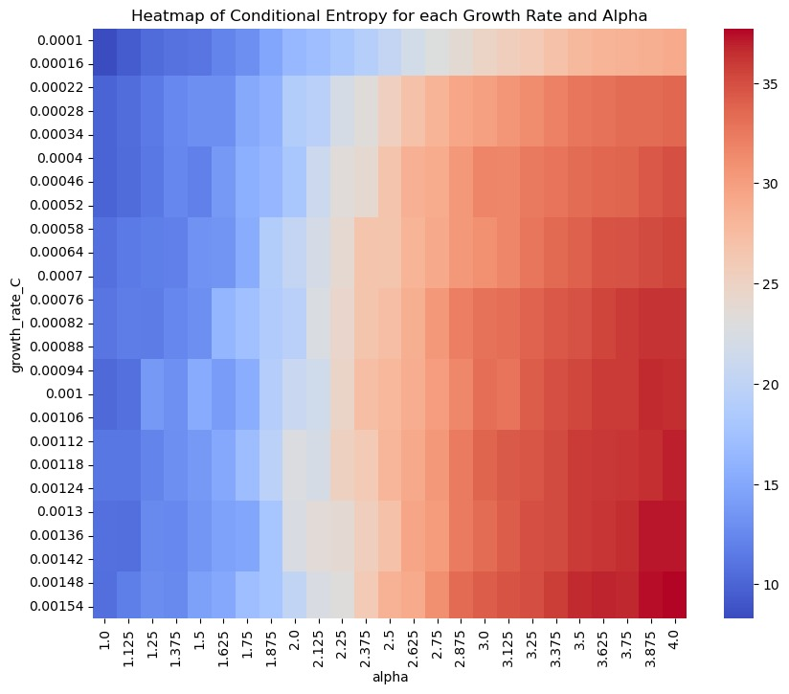
Analysis II - Conditional Entropy

Slide 16
Analysis III - Residential Area Cluster Size Distribution
Base paper (in some situations) finds power law in cluster size distribution
Our analysis is inconclusive

Slide 17
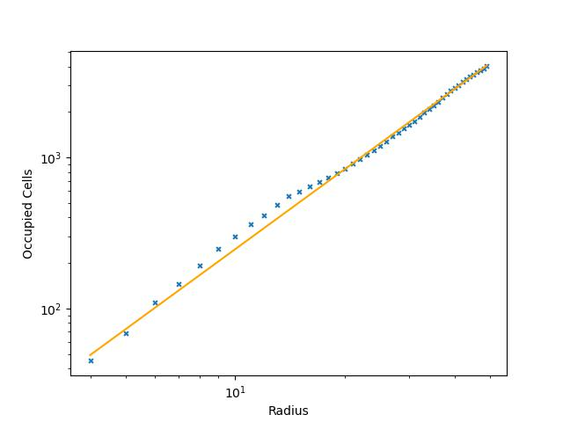
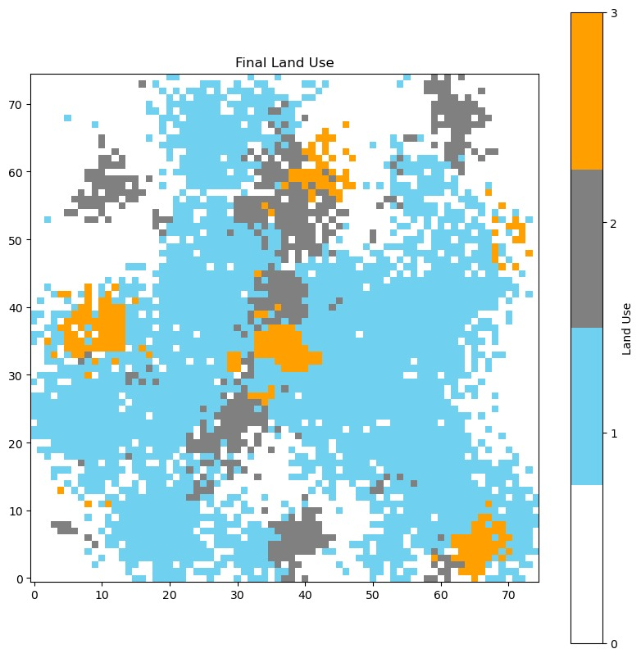
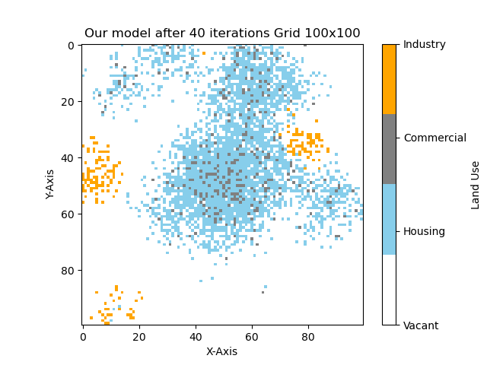
Analysis IV - Fractal Dimension
Basic Idea:
Number of cells in each radius to the center.
fit a curve (line in loglog) to data

Slide 18
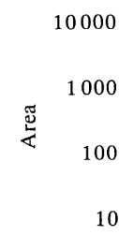
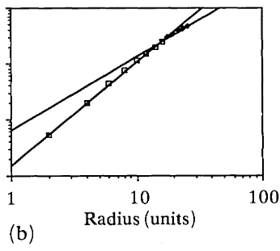
Analysis IV - Result from Paper
Fractal Dimension in the paper
Fractal Dimension in our model

Slide 19
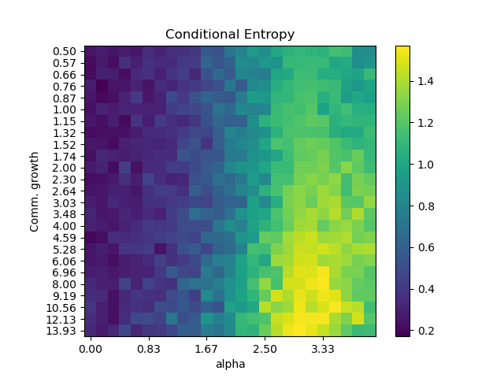
Analysis V - Our Model
The difference:
Takes the Potential from the paper
assigns new state based on probability weights
organic approach
Results
few similar structures in form
less clustering of C
low occurrence of I

Slide 20

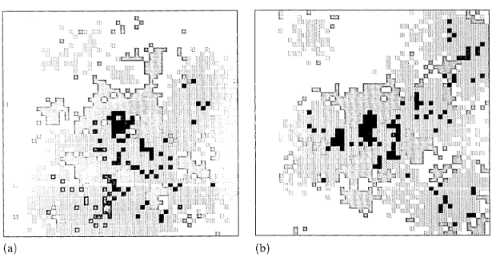
Conclusion
Model to analyse the City growth
produced comparable structures
Emergent behavior
Alpha value
Further research
More parameters/policies
underlying landscape
(a)

Slide 21
The end
Thank you for listening

Slide 22
References
White, R., & Engelen, G. (1993). Cellular automata and fractal urban form: a cellular modelling approach to the evolution of urban land-use patterns. Environment and planning A, 25(8), 1175-1199.
Javaheri Javid, M. A., Blackwell, T., Zimmer, R., & Al-Rifaie, M. M. (2015). Spatial complexity measure for characterising cellular automata generated 2D patterns. In Progress in Artificial Intelligence: 17th Portuguese Conference on Artificial Intelligence, EPIA 2015, Coimbra, Portugal, September 8-11, 2015. Proceedings 17 (pp. 201-212). Springer International Publishing.
Aburas, M. M., Ho, Y. M., Ramli, M. F., & Ash’aari, Z. H. (2016). The simulation and prediction of spatio-temporal urban growth trends using cellular automata models: A review. International Journal of Applied Earth Observation and Geoinformation, 52, 380-389.
United Nations (2015) World urbanization prospects: the 2014 revision.

Slide 23
Appendix

Slide 24
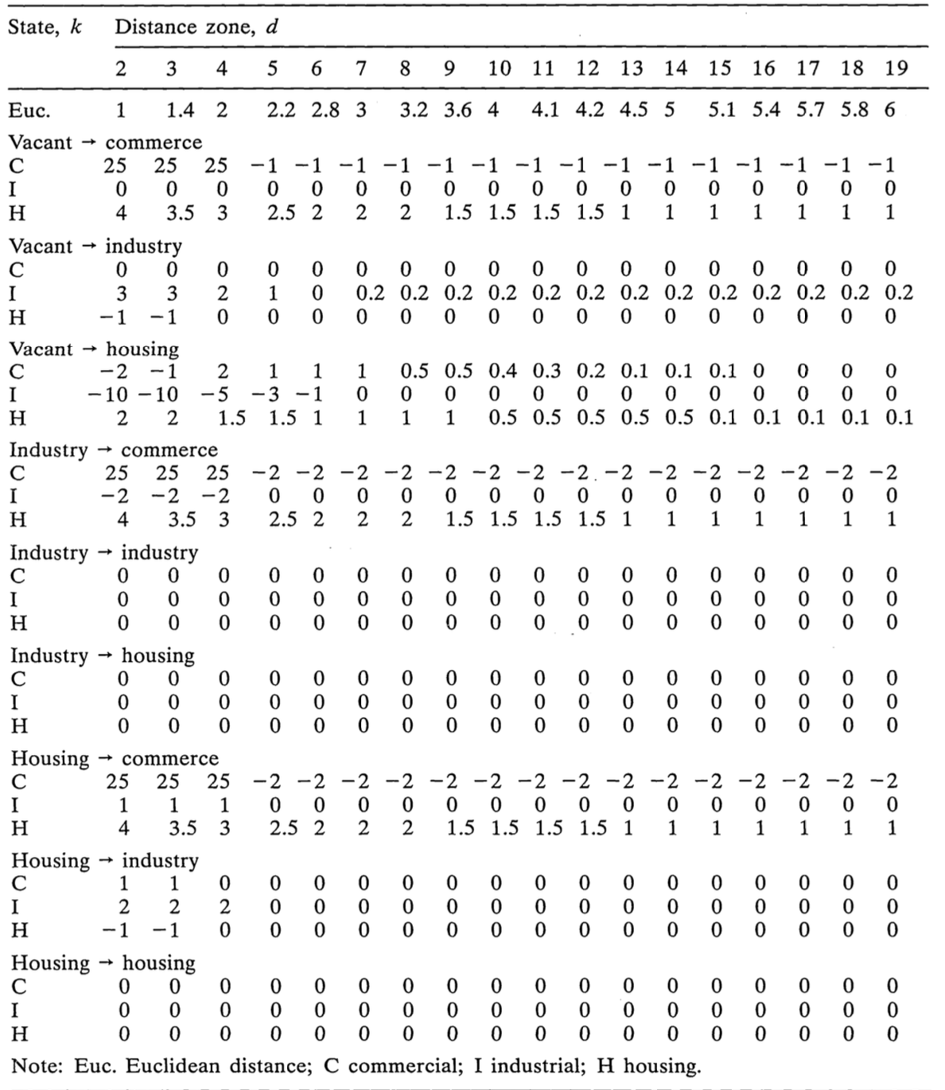
Complete weight table
White, R., & Engelen, G. (1993). Cellular automata and fractal urban form: a cellular modelling approach to the evolution of urban land-use patterns. Environment and planning A, 25(8), 1175-1199.

Slide 25
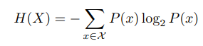
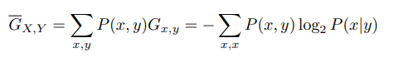
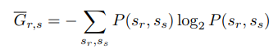
Details for (conditional) Entropy
Normal Entropy
Conditional Entropy
Conditional Entropy can be calculated for a 2D pattern by considering the distribution of cell states over pairs of cells r, s,

Slide 26
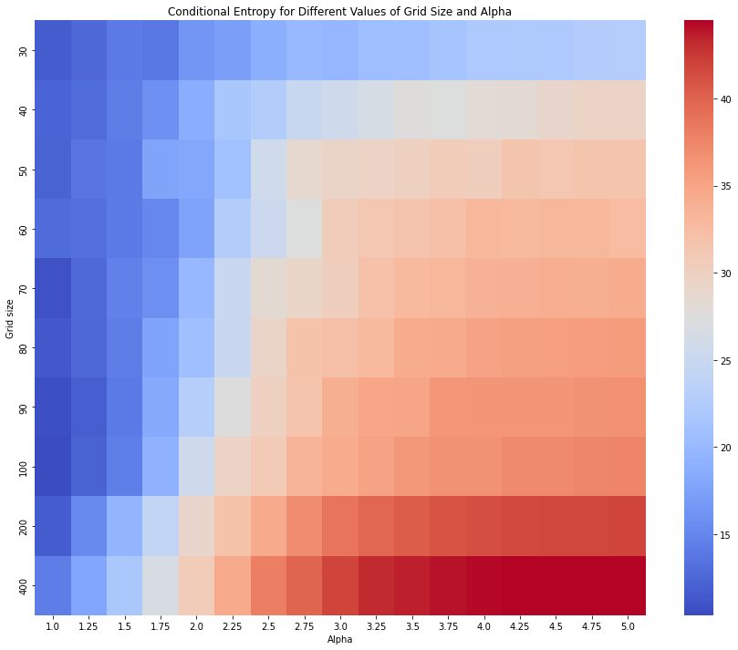
Conditional Entropy (Varying alpha and grid size)
With greater system size, the conditional entropy grows more rapidly

Slide 27
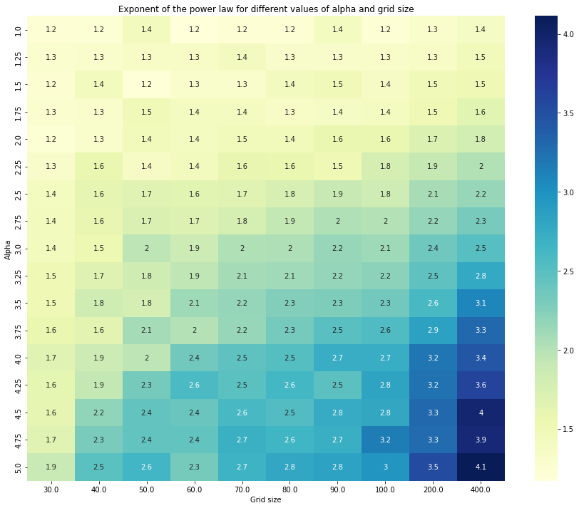
Power Law study of Cluster Size(varying alpha and grid size)
For larger system size, the power law exponent becomes larger and stable.

Slide 28
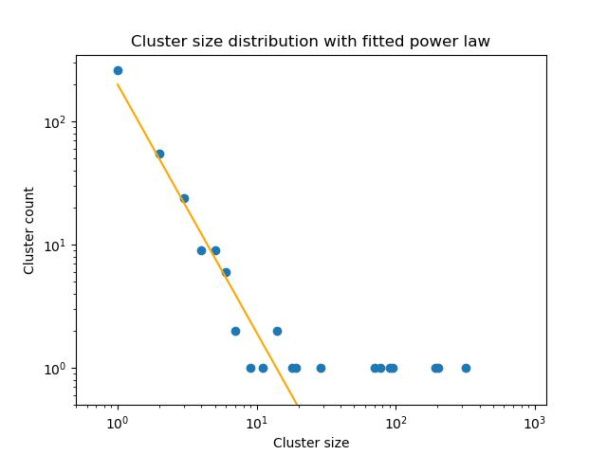
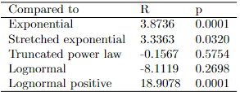
Residential Area Cluster Size Distribution
What we do: calculate clusters on grid, fit a power law to the clusters, run statistical tests.
Example of power law distribution compared to 5 other distributions

Slide 29
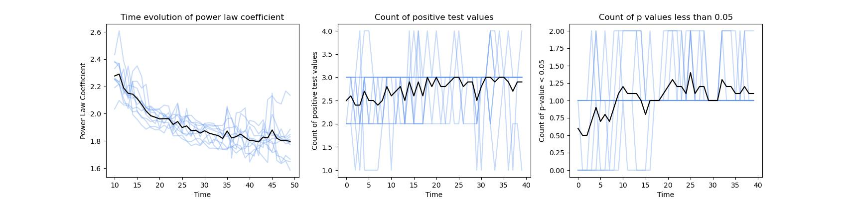
Residential Area Cluster Size Distribution
In the left graph, we estimate the power law coefficient over time and find a value between 2.3 and 1.8 for every time step. In the middle graph, we see the average amount of tests where a power law distribution is more likely than the distribution to which it is being compared. The right graph shows the average amount of tests for which power law is significantly more likely than the distribution to which it is being compared.
We do not find strong evidence for a power law

Slide 30
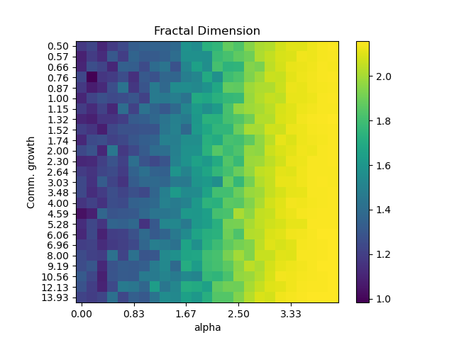
Fractal dimension in our model
Phase transition
an effect of alpha can be seen at ~1.7
Interpretation
increasing alpha leads to increased fractal patterns
a growth rate for comm. not relevant

Slide 31
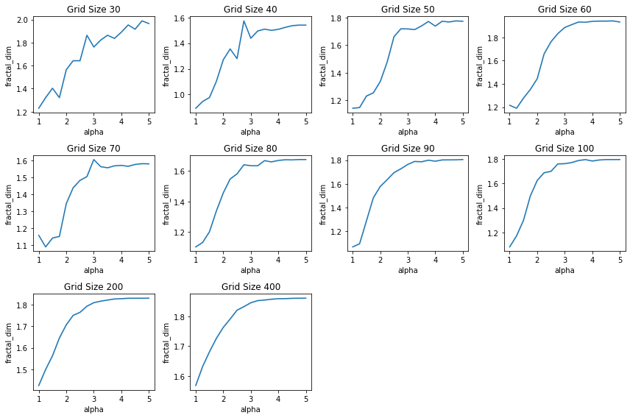
Fractal Dimension (varying alpha and grid size)
We see a smoother curve for the fractal dimension as we increase the grid size.
As we increase alpha, the fractal dimension increases because

Slide 32
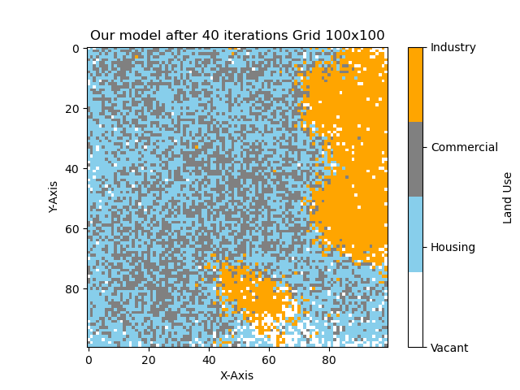
Our model solution with high alpha

